Slide 1

企划资料查询系统说明

Slide 2
生产企划处使用程式清单

Slide 3
外延使用程式清单

Slide 4
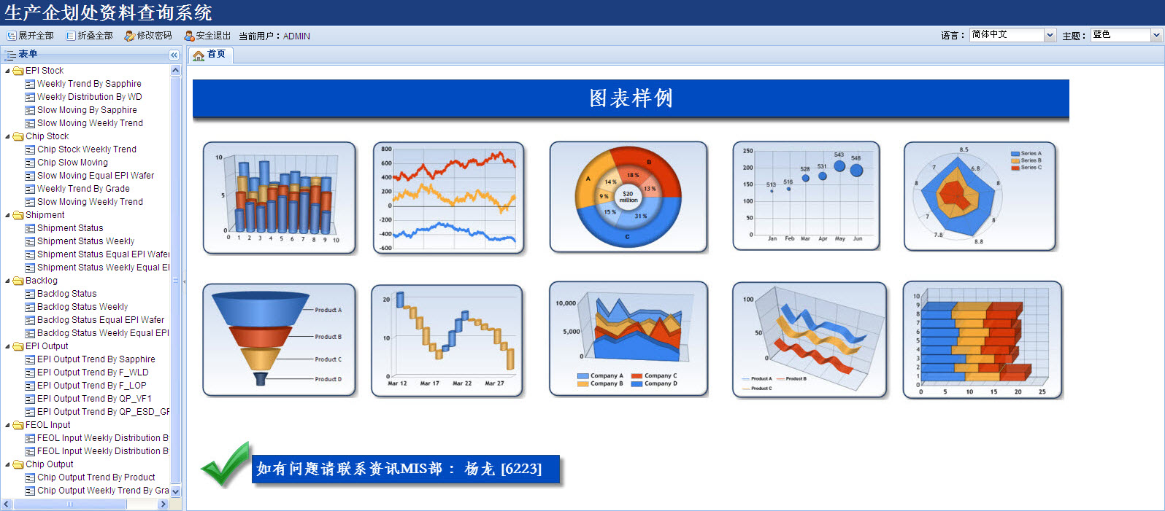
主界面

Slide 5
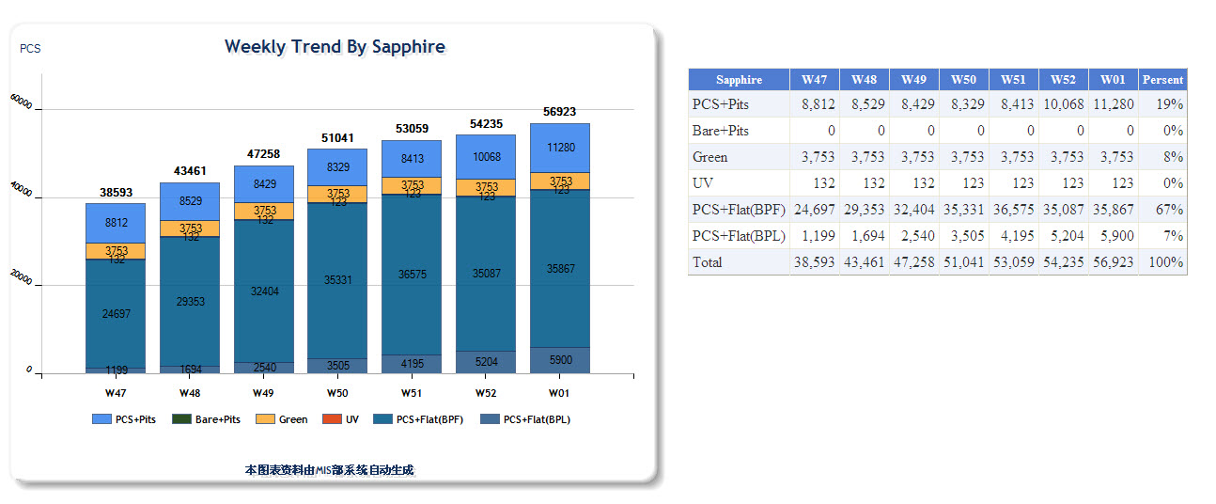
EPI Stock - Weekly By Sapphire 报表

Slide 6
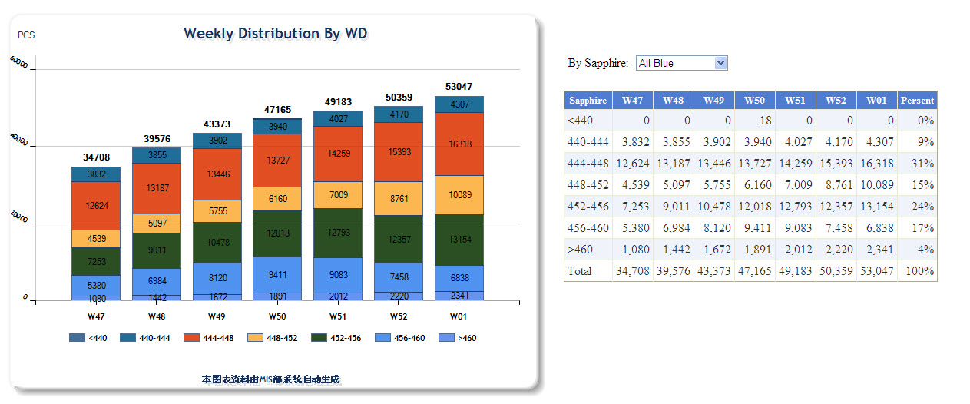
EPI Stock - Weekly Distribution By WD报表

Slide 7
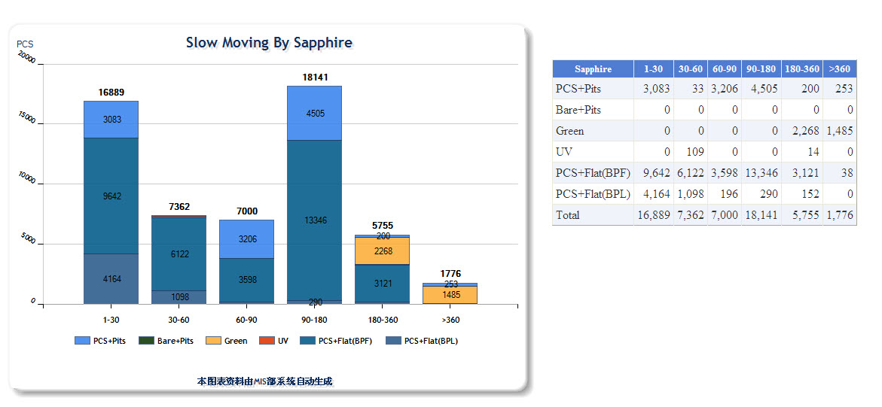
EPI Stock - Slow Moving By Sapphire报表

Slide 8
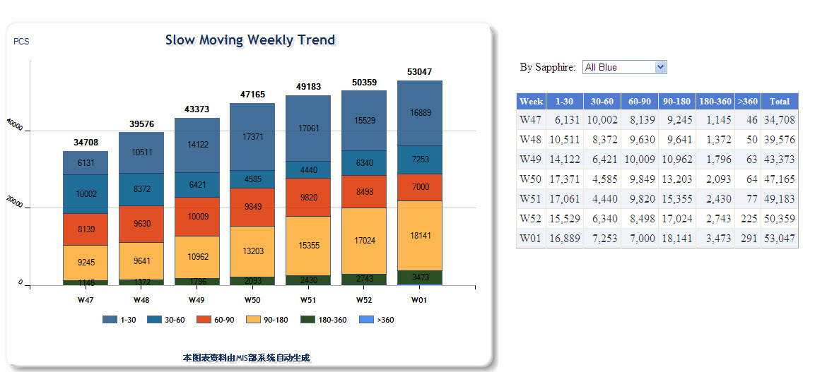
EPI Stock - Slow Moving Weekly Trend报表

Slide 9
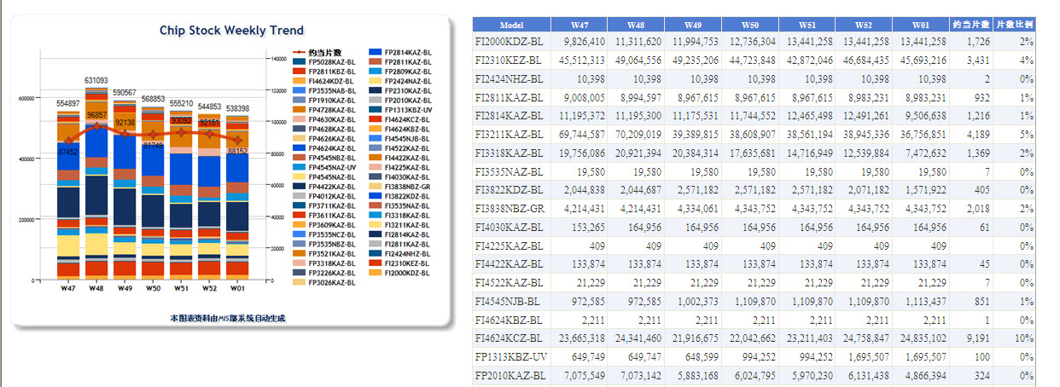
CHIP Stock - Chip Stock Weekly Trend报表

Slide 10
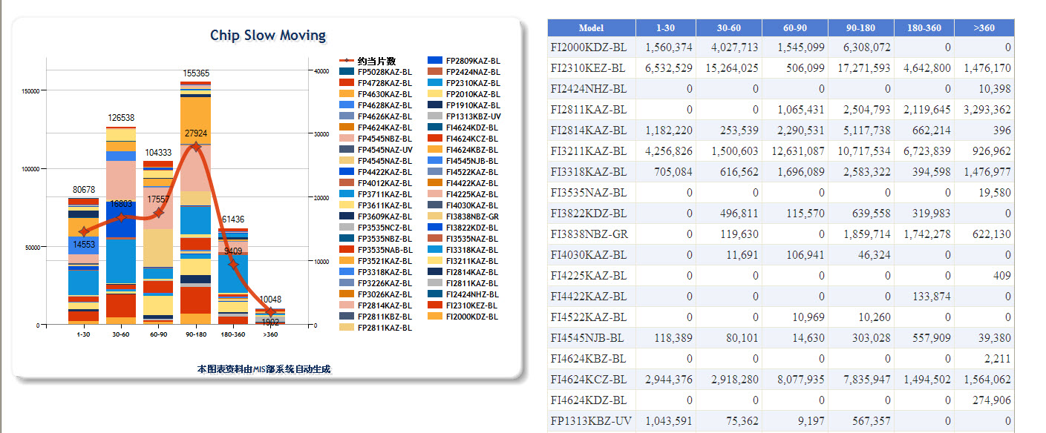
CHIP Stock - Chip Slow Moving报表

Slide 11
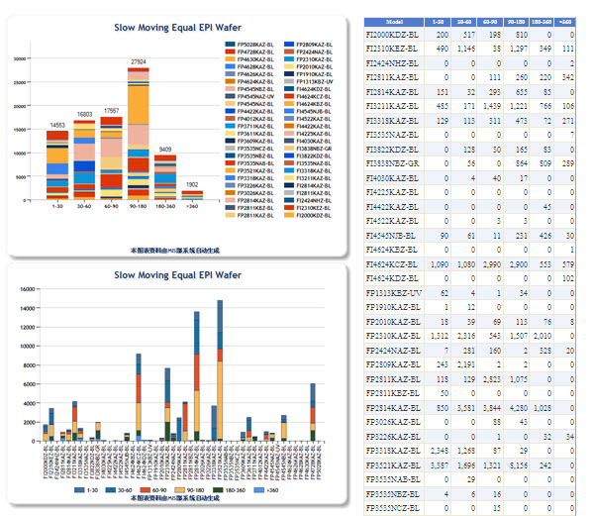
CHIP Stock - Slow Moving Equal EPI Wafer报表

Slide 12
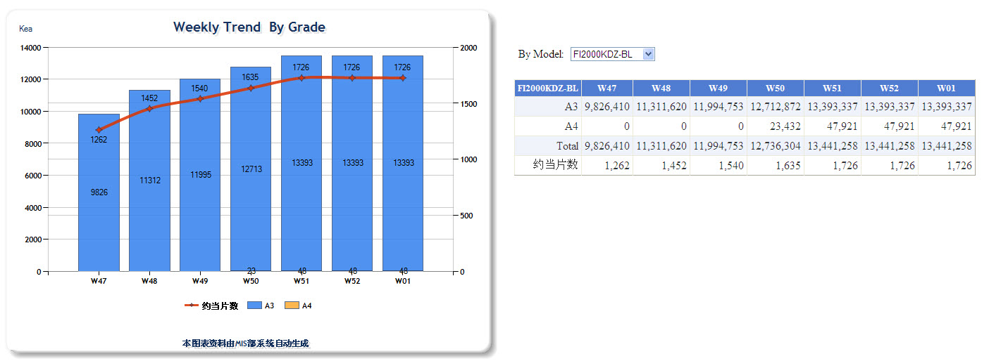
CHIP Stock - Weekly Trend By Grade报表

Slide 13
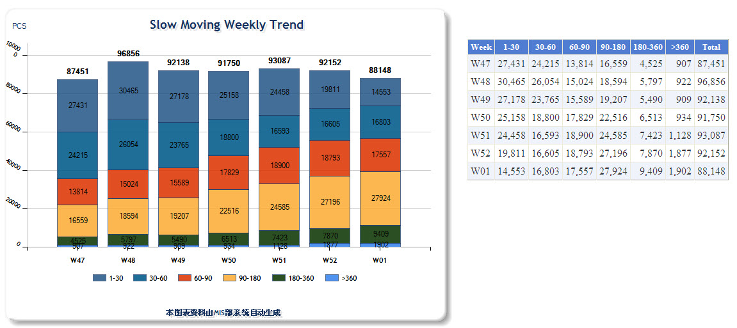
CHIP Stock - Slow Moving Weekly Trend报表

Slide 14
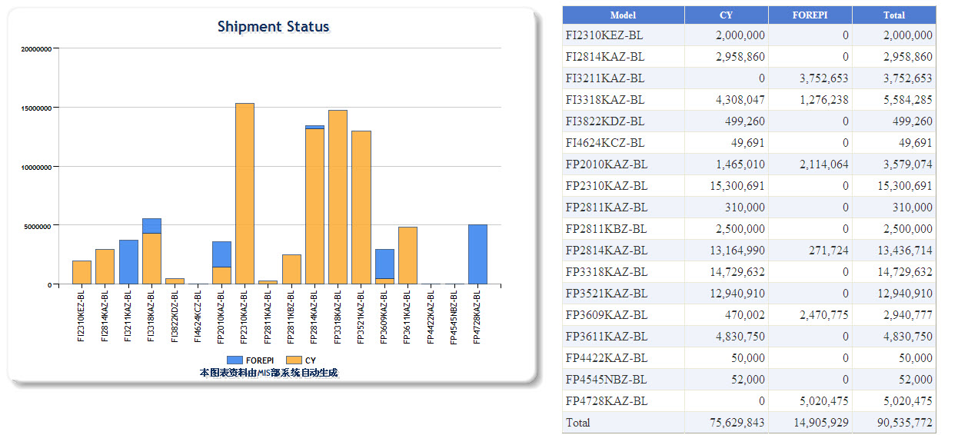
Shipment- Shipment Status报表

Slide 15
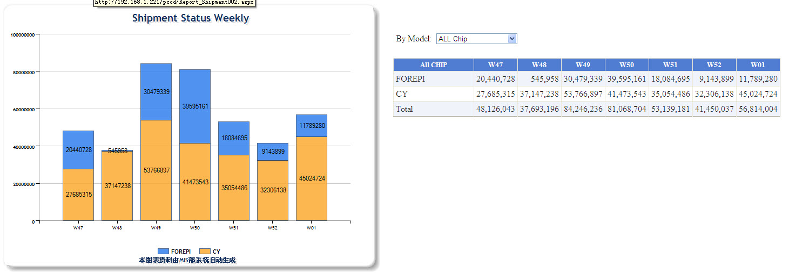
Shipment- Shipment Status Weekly报表

Slide 16
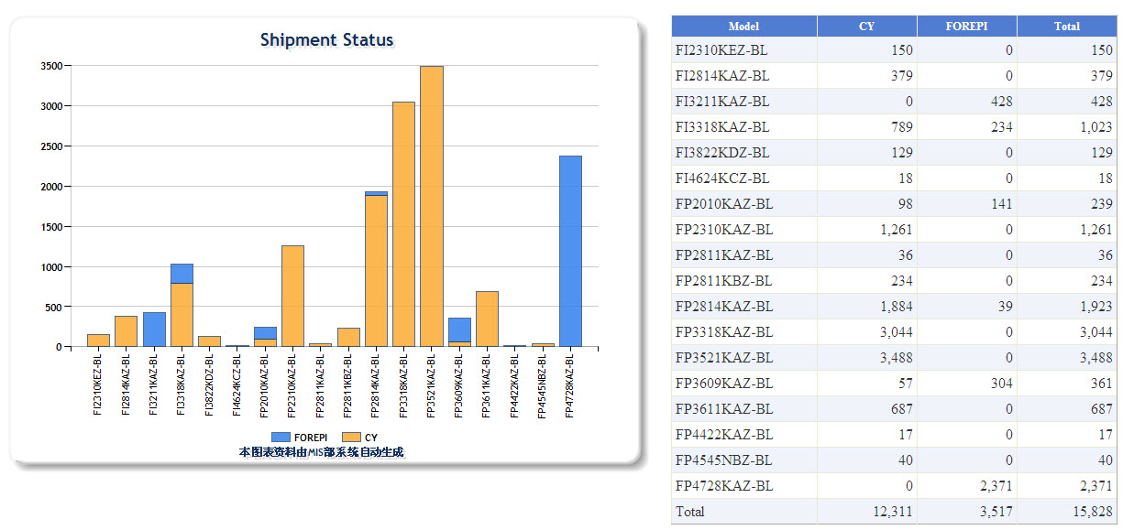
Shipment- Shipment Status Equal EPI Wafer报表

Slide 17
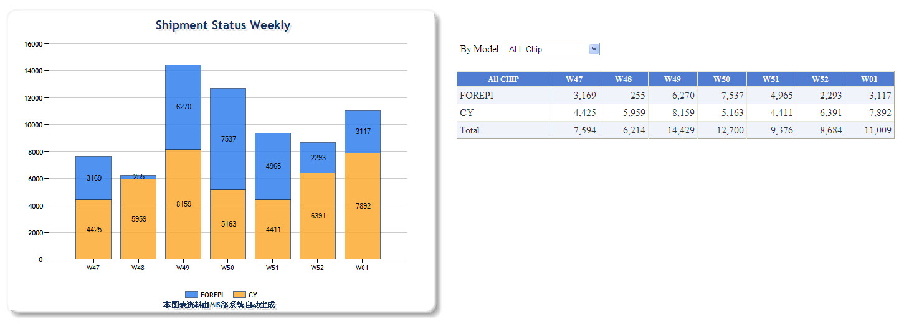
Shipment- Shipment Status Weekly Equal EPI Wafer报表

Slide 18
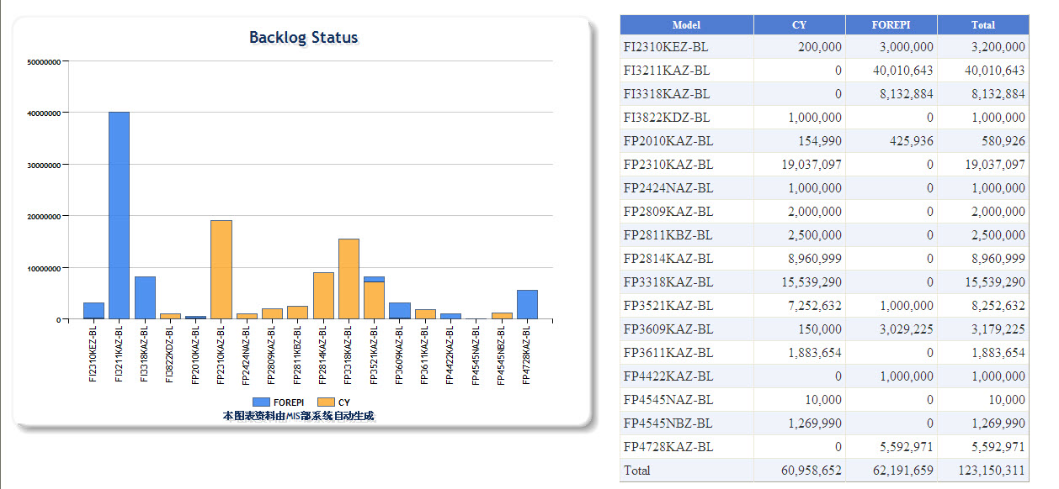
Backlog- Backlog Status报表

Slide 19
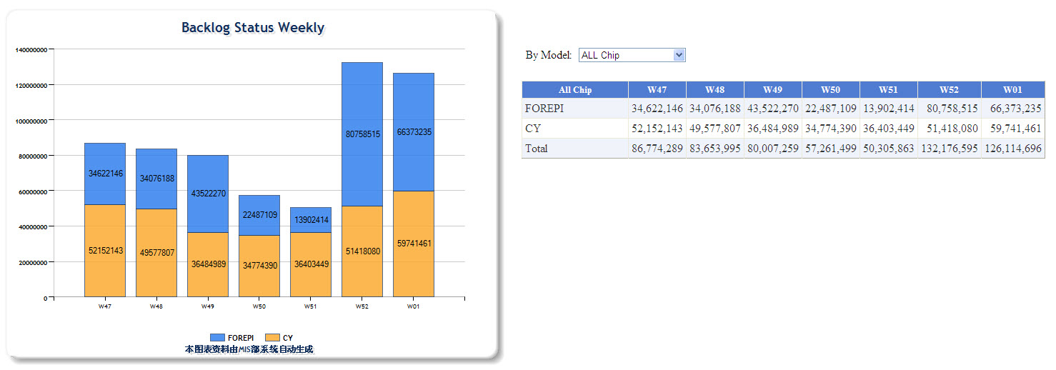
Backlog- Backlog Status Weekly报表

Slide 20
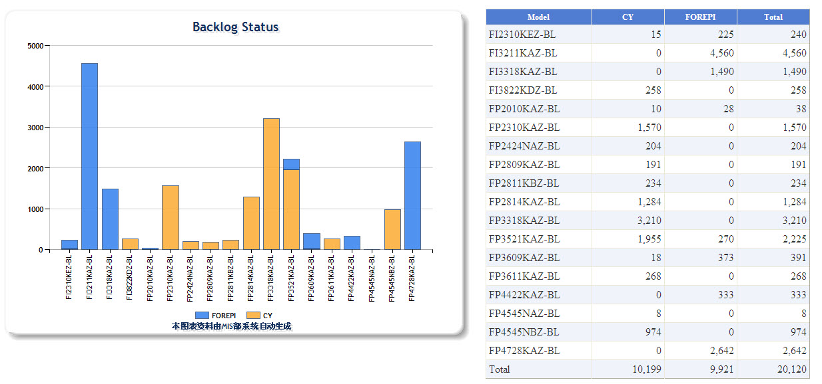
Backlog- Backlog Status Equal EPI Wafer报表

Slide 21
Backlog- Shipment Status Weekly Equal EPI Wafer报表

Slide 22
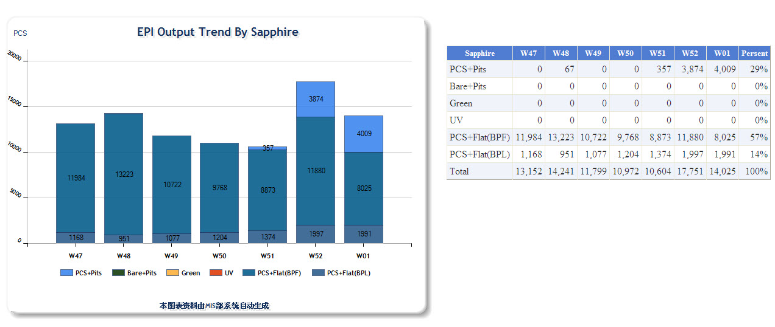
EPI Output- EPI Output Trend By Sapphire报表

Slide 23
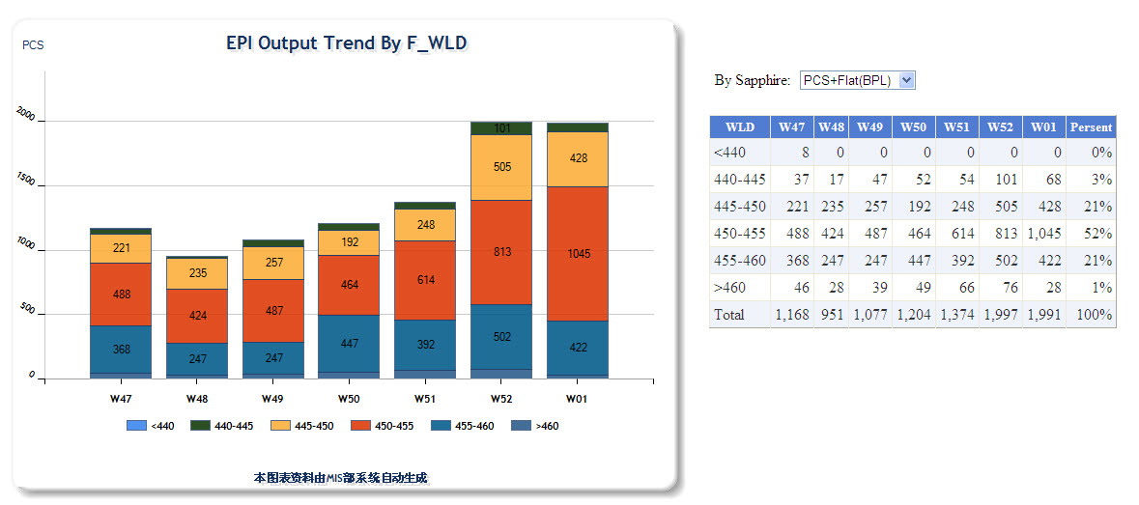
EPI Output- EPI Output Trend By F_WLD报表

Slide 24
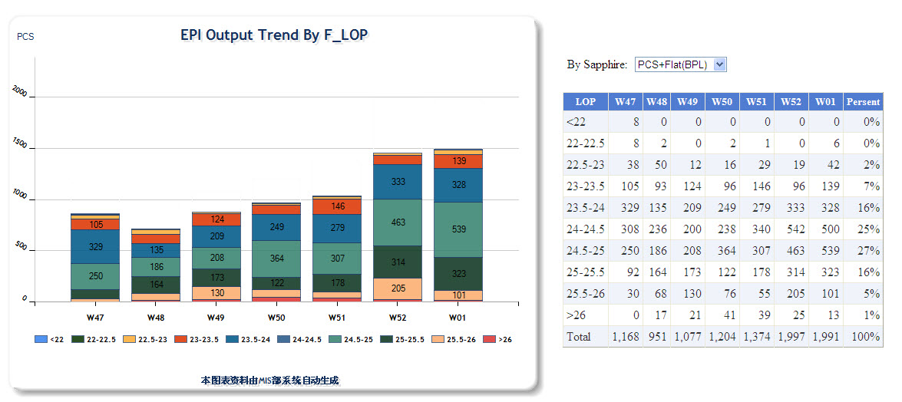
EPI Output- EPI Output Trend By F_LOP报表

Slide 25
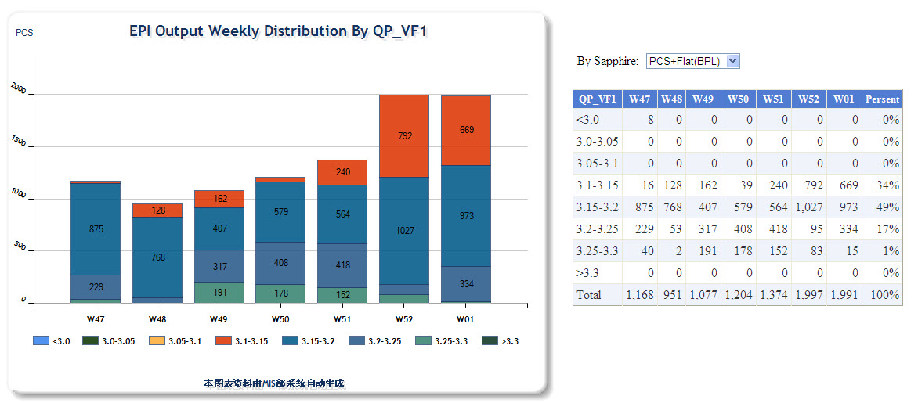
EPI Output- EPI Output Trend By QP_VF1报表

Slide 26
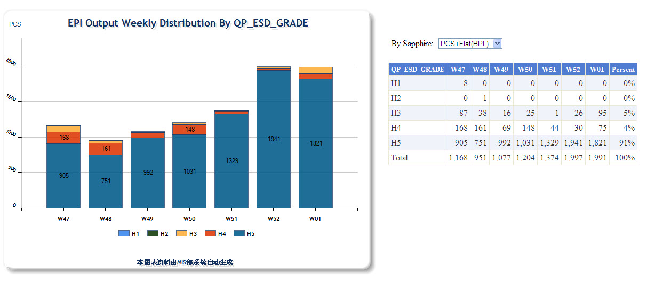
EPI Output- EPI Output By QP_ESD_GRADE报表

Slide 27
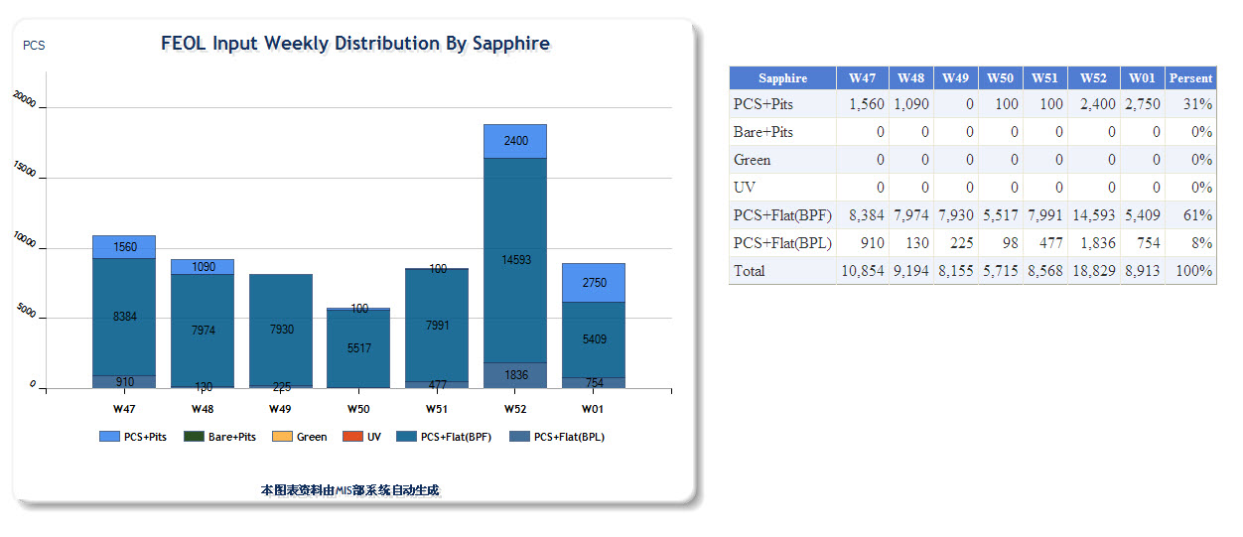
FEOL Input-FEOL Input Weekly Distribution By Sapphire报表

Slide 28
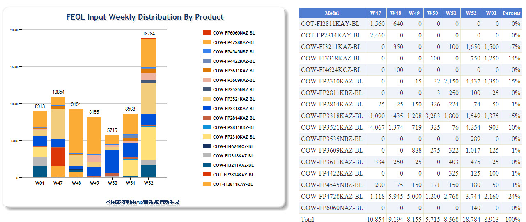
FEOL Input-FEOL Input Weekly Distribution By Product报表

Slide 29
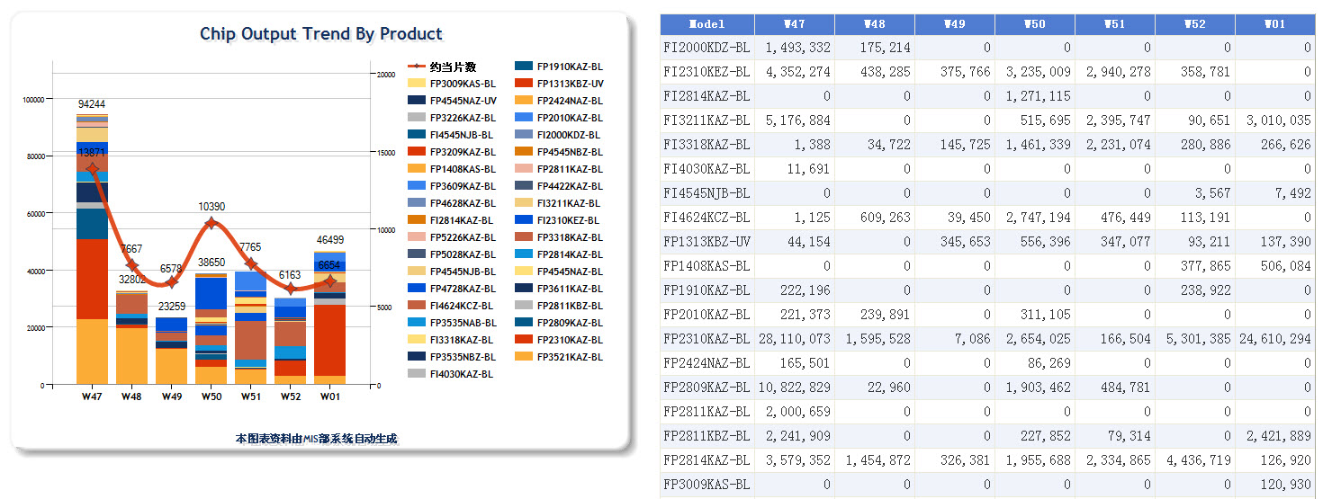
Chip Output-Chip Output Trend By Product报表

Slide 30
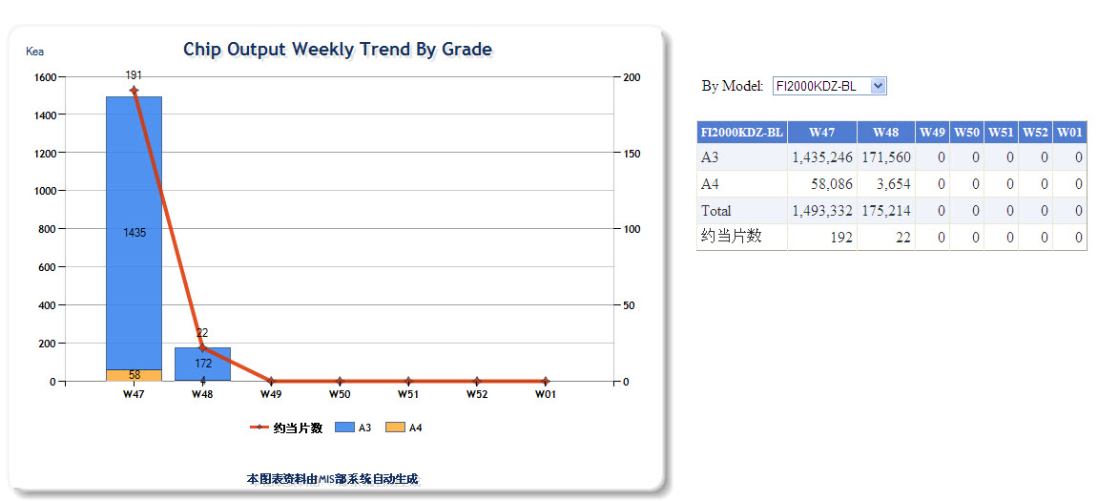
Chip Output-Chip Output Weekly Trend By Grade报表

Slide 31
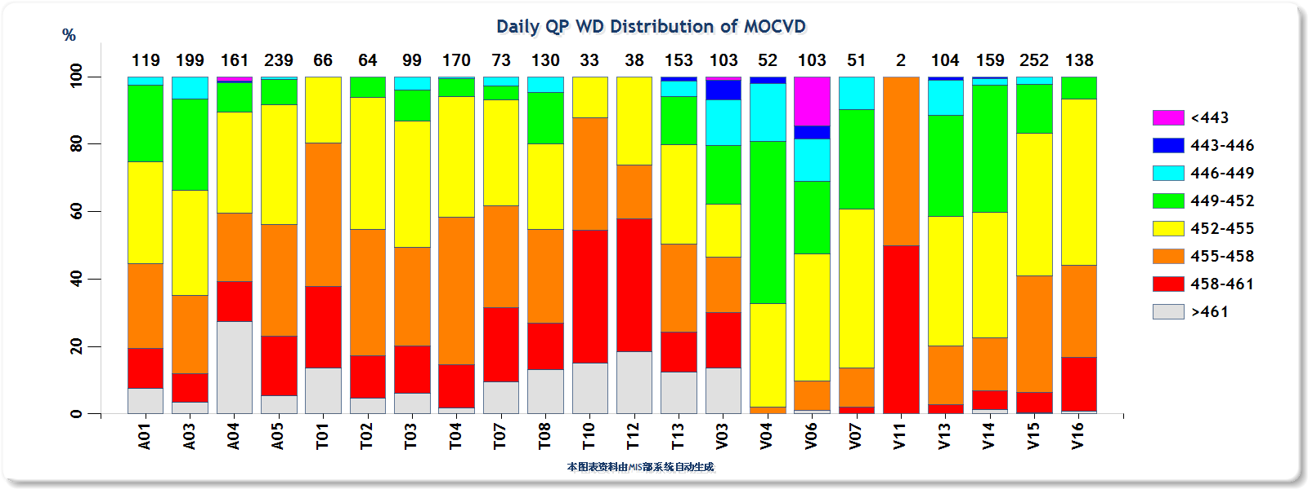
QP Day-Daily QP WD Distribution of MOCVD报表

Slide 32
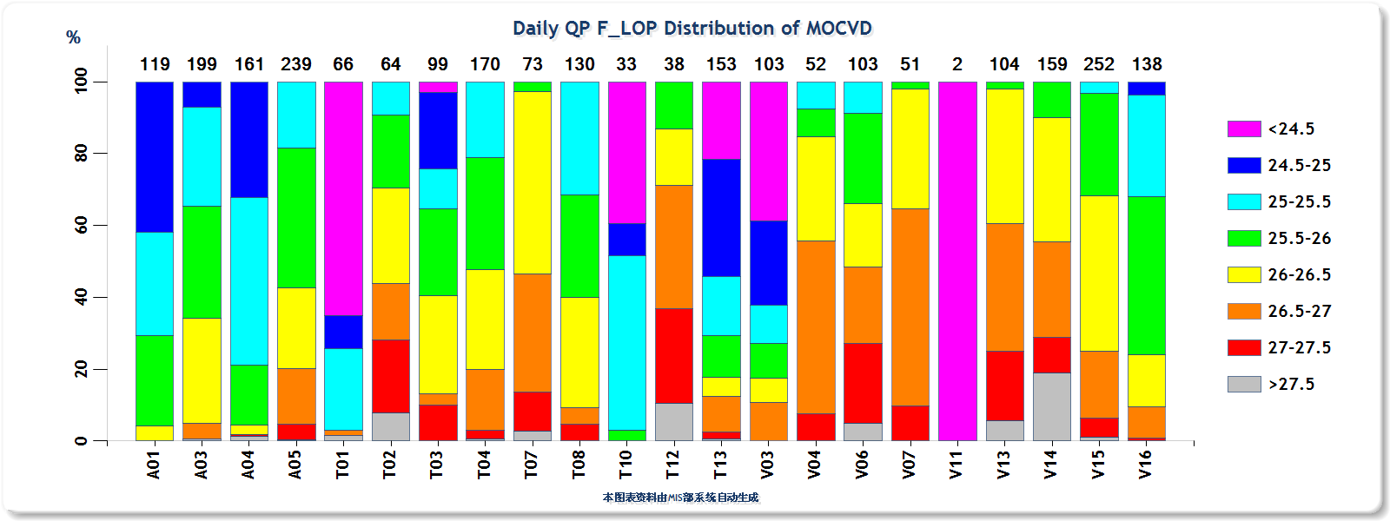
QP Day-Daily QP F_LOP Distribution of MOCVD报表

Slide 33
QP Day-Daily QP VF Distribution of MOCVD报表

Slide 34
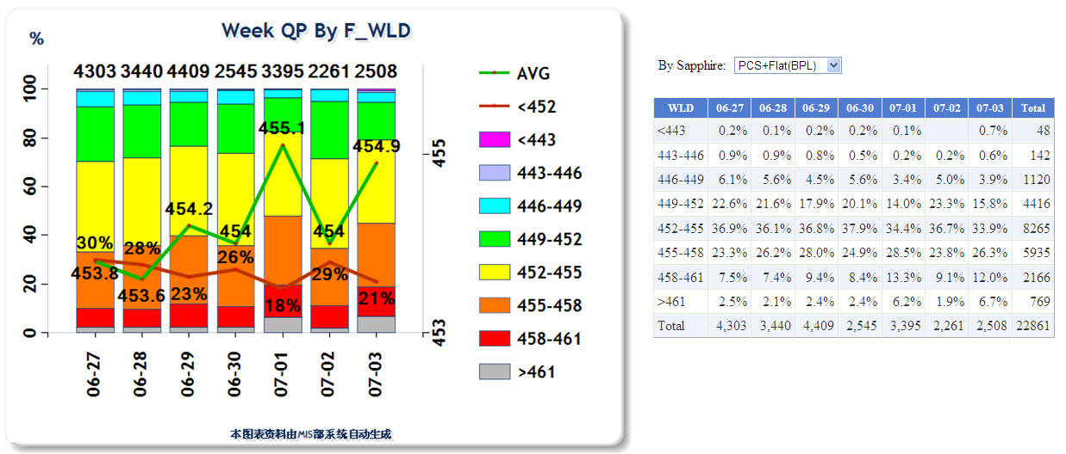
QP Week-Week QP by F_WLD报表

Slide 35
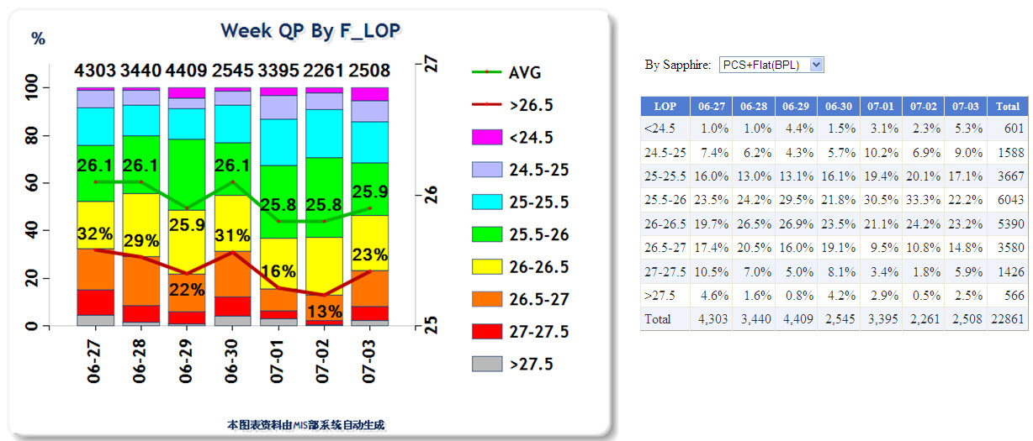
QP Week-Week QP by F_LOP报表

Slide 36
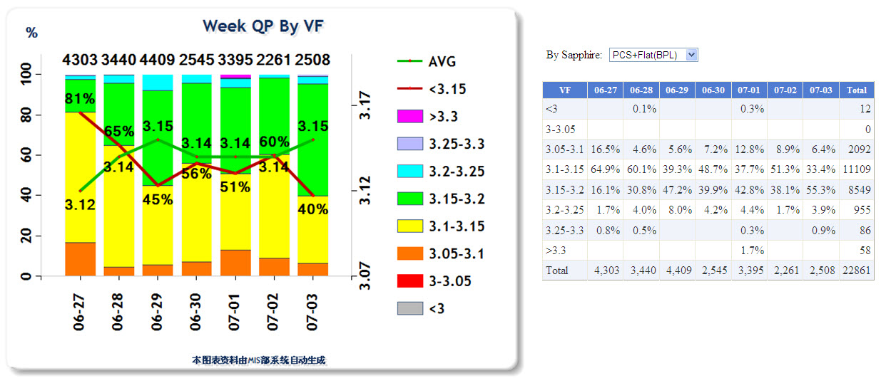
QP Week-Week QP by F_VF报表

Slide 37
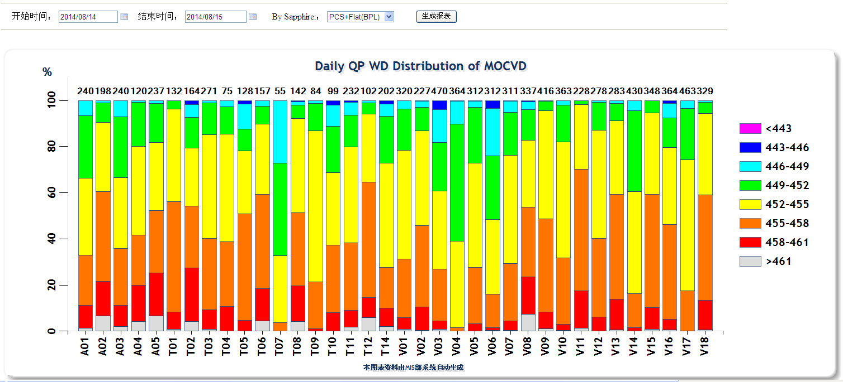
QP Day-Daily QP WD Distribution of MOCVD[外延]报表

Slide 38
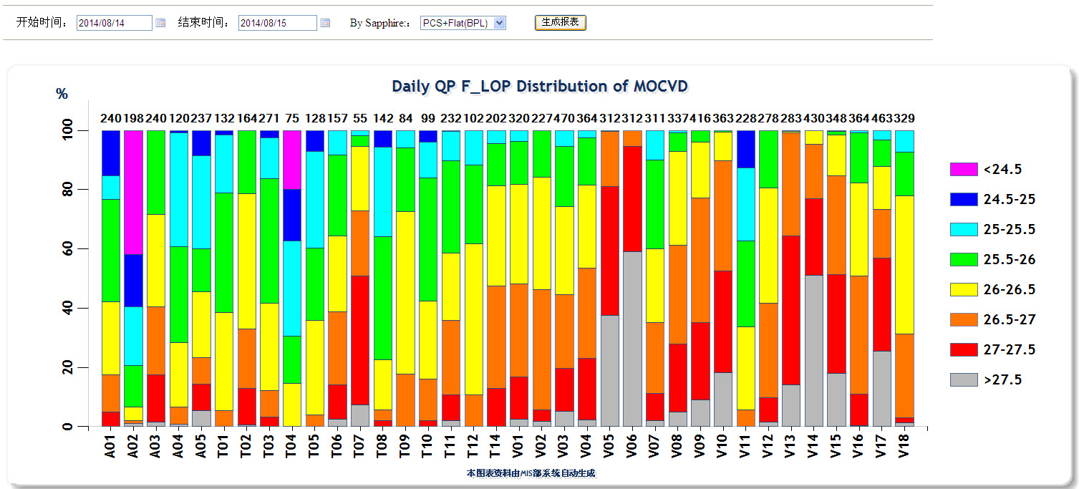
QP Week-Week QP by F_LOP[外延]报表

Slide 39
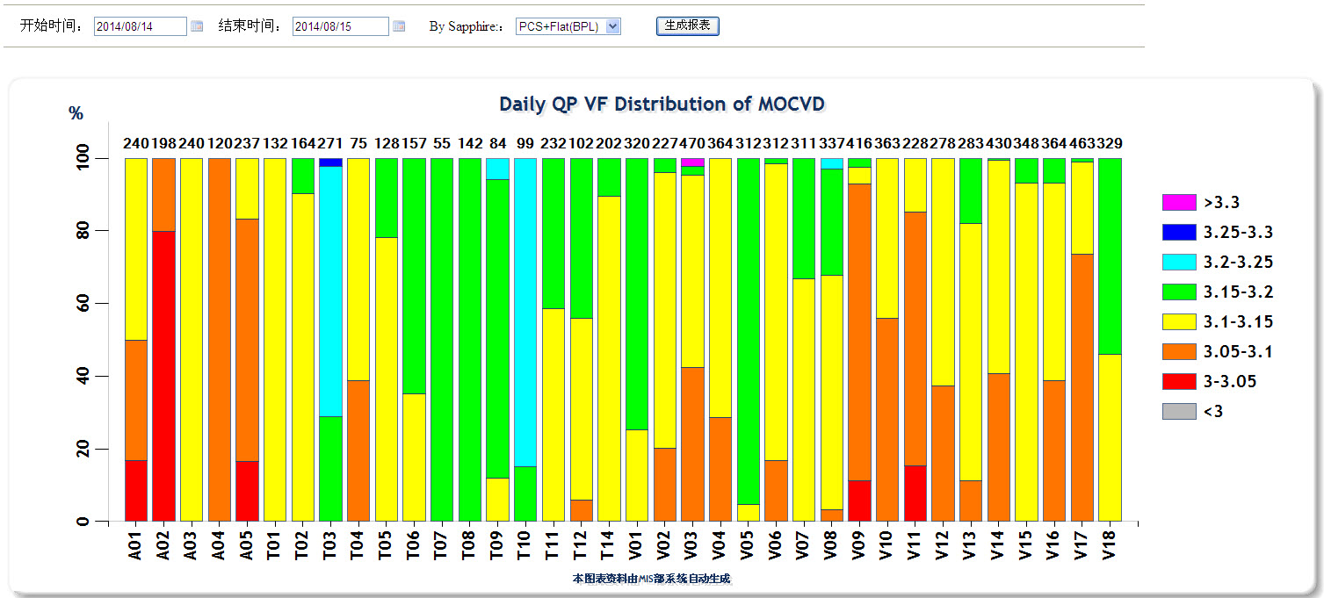
QP Day-Daily QP VF Distribution of MOCVD[外延]报表

Slide 40
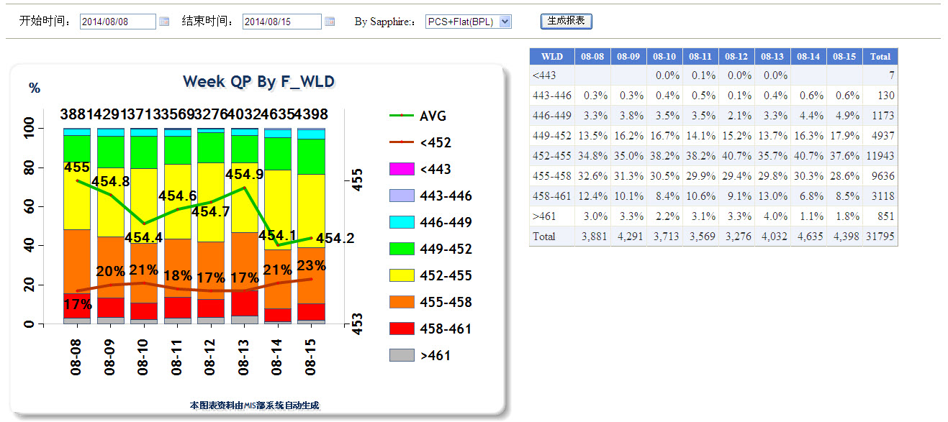
QP Week-Week QP by F_WLD[外延]报表

Slide 41
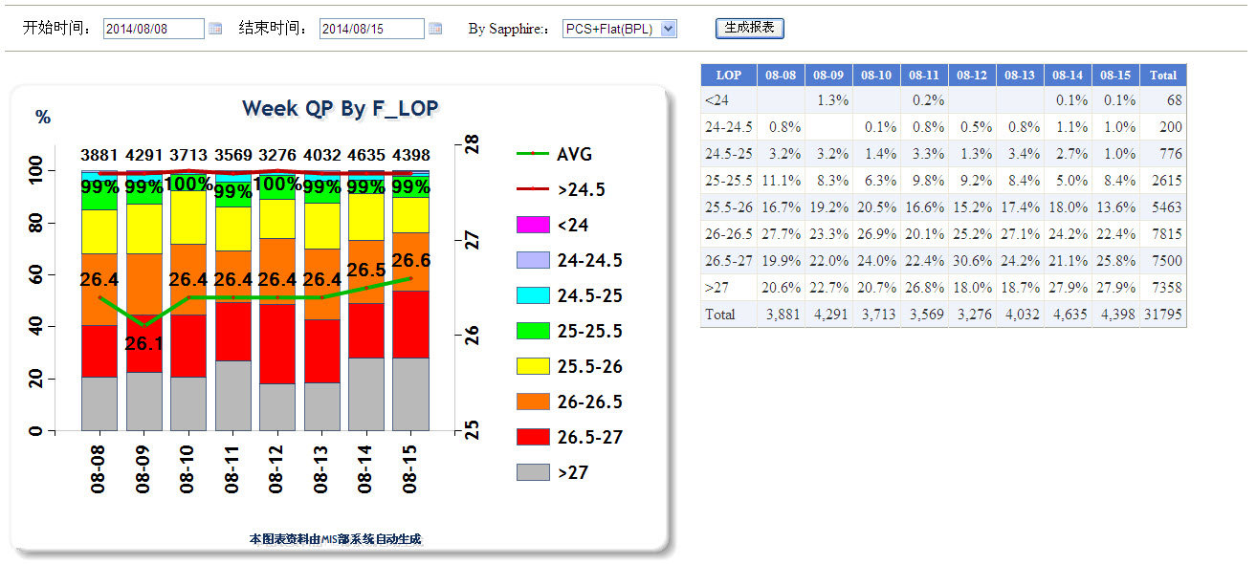
QP Week-Week QP by F_LOP[外延]报表

Slide 42
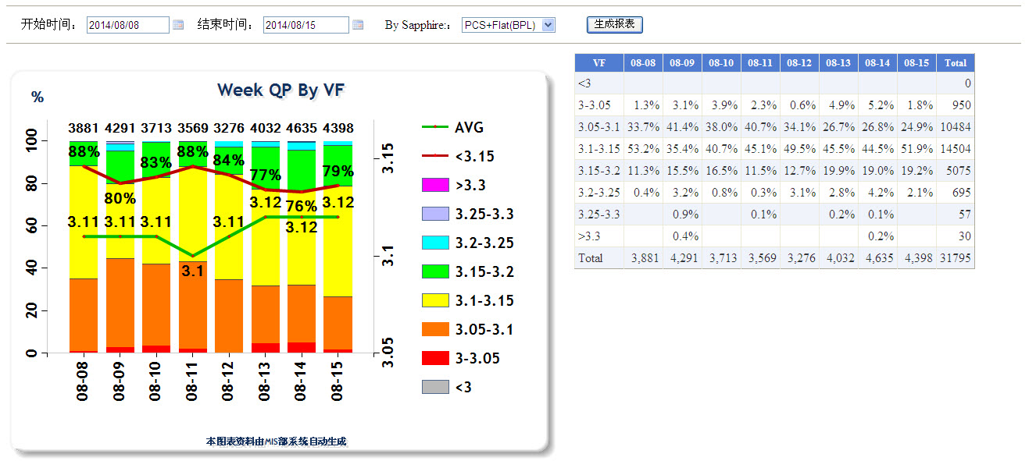
QP Week-Week QP by F_VF[外延]报表

